Slide 1

inemania
Chris, Sally, Kyle and Adrian

Slide 2
The Problem
An overwhelming and scattered amount of information for what should be a quick decision.
Hard to access information for the computer illiterate

Slide 3
Solution
One click is all you need to get everything you’d want for three trailers and three reviews

Slide 4
Steps and Code
Sally
Chris
Kyle
Adrian

Slide 5
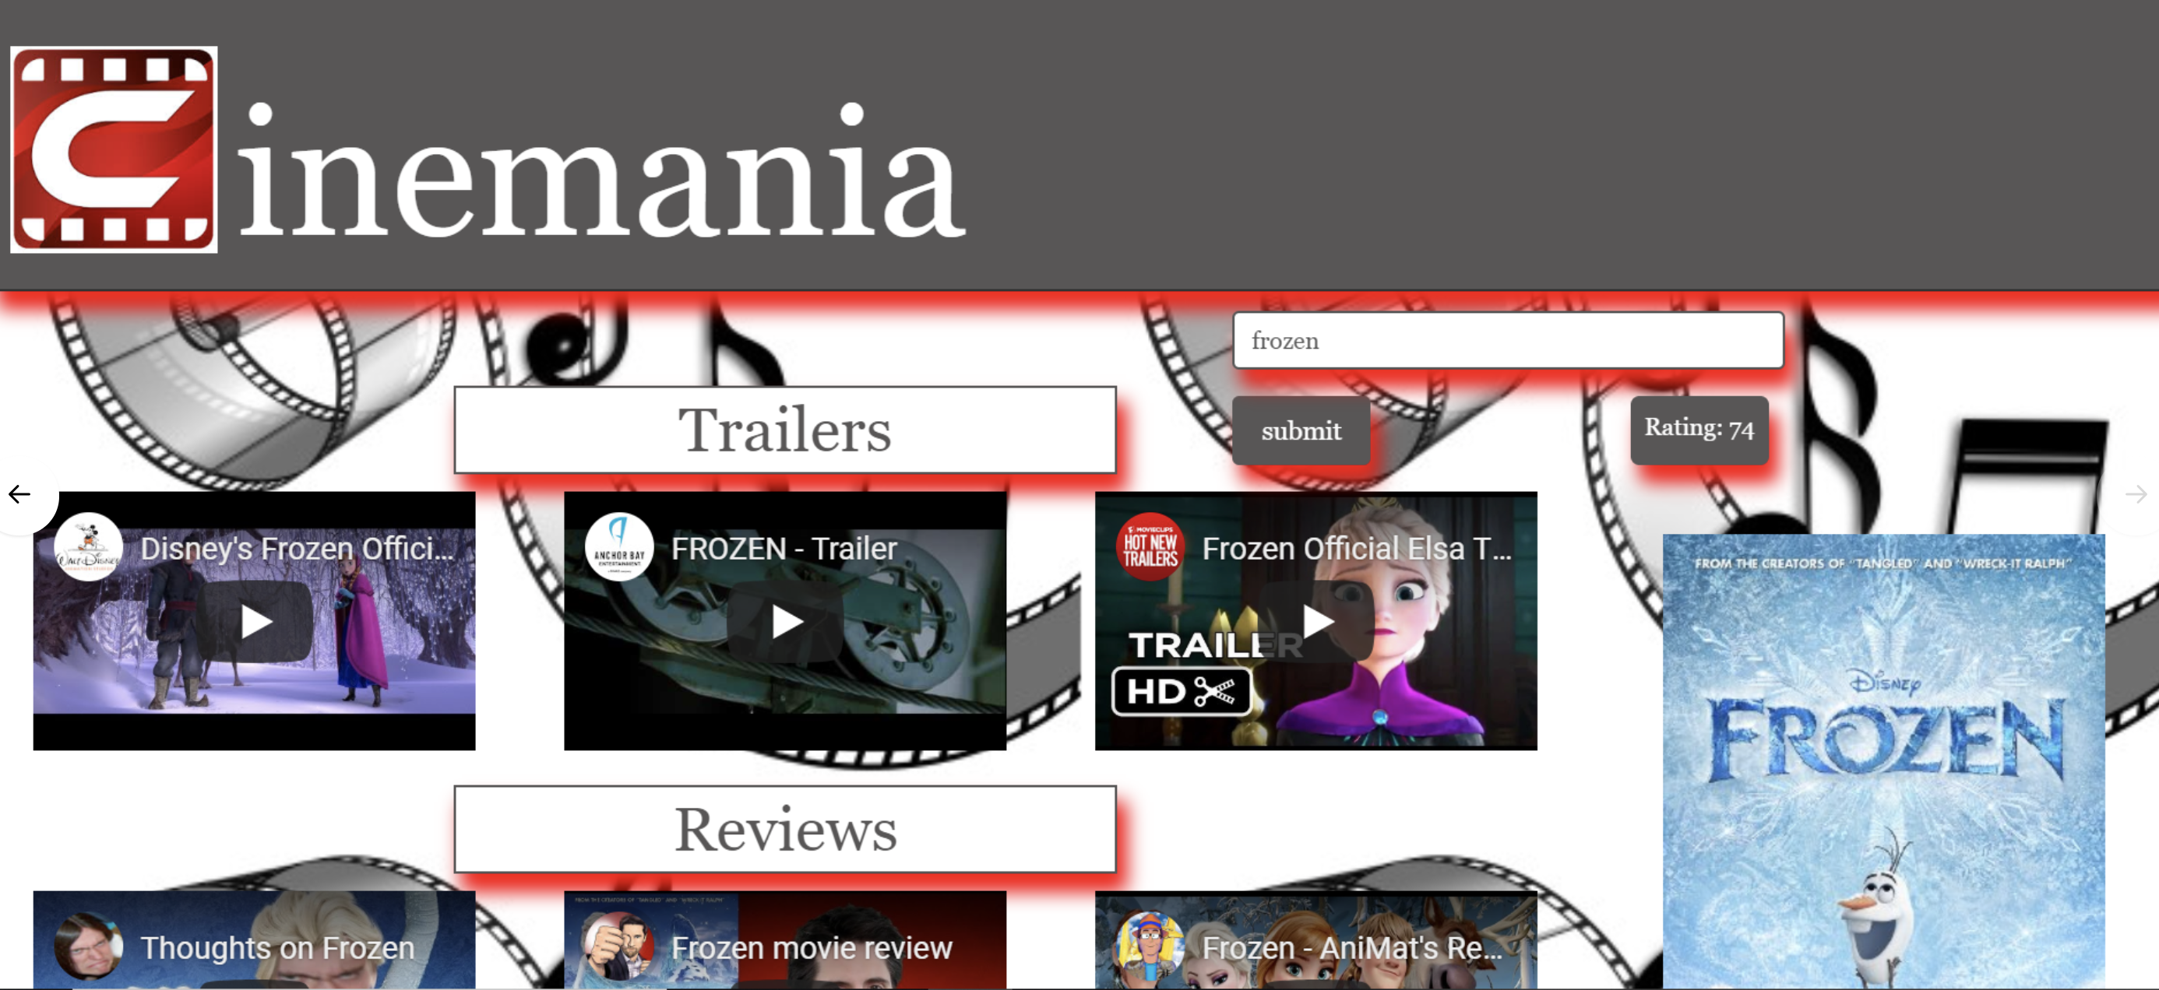

Slide 6
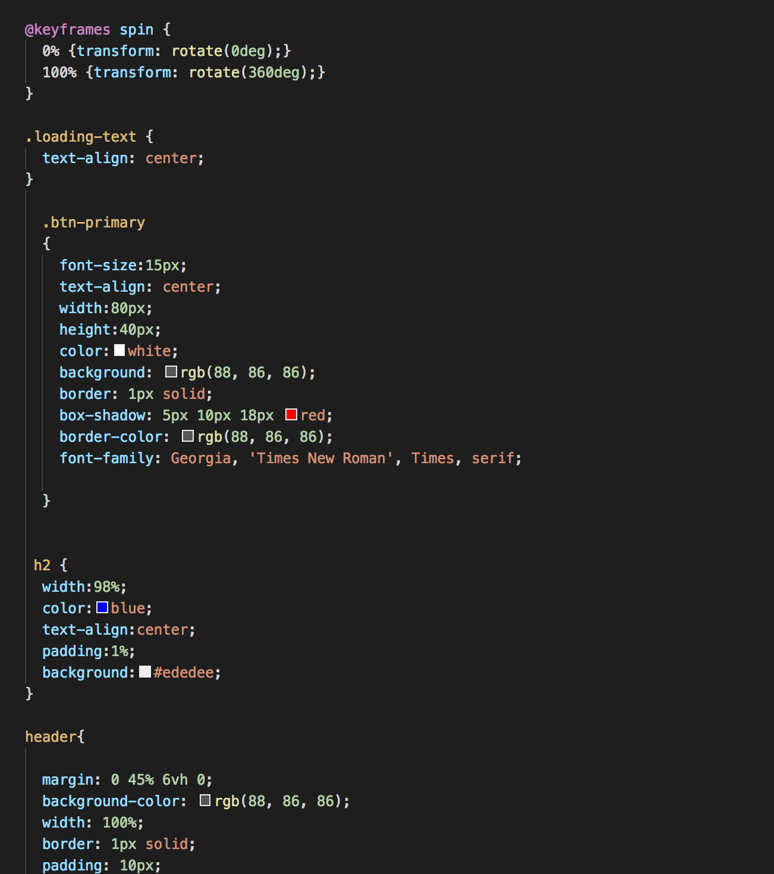

Slide 8
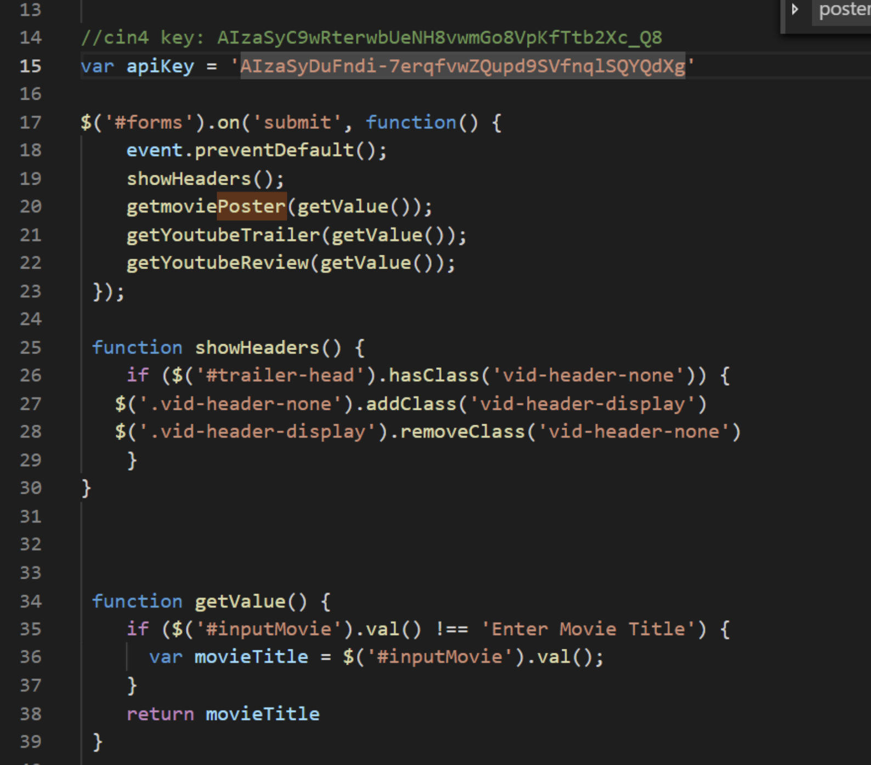
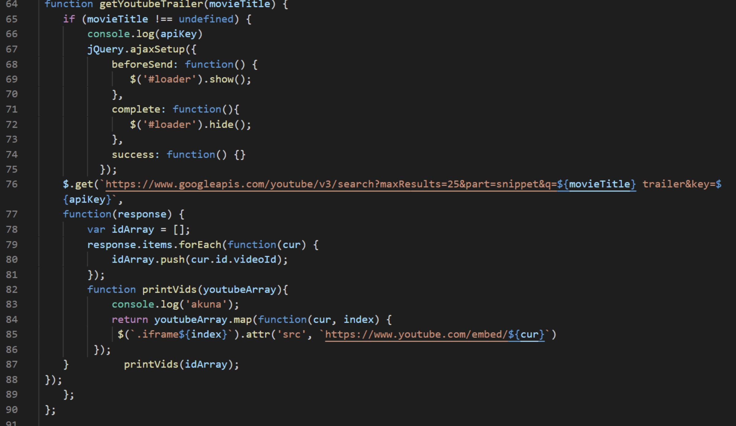

Slide 9

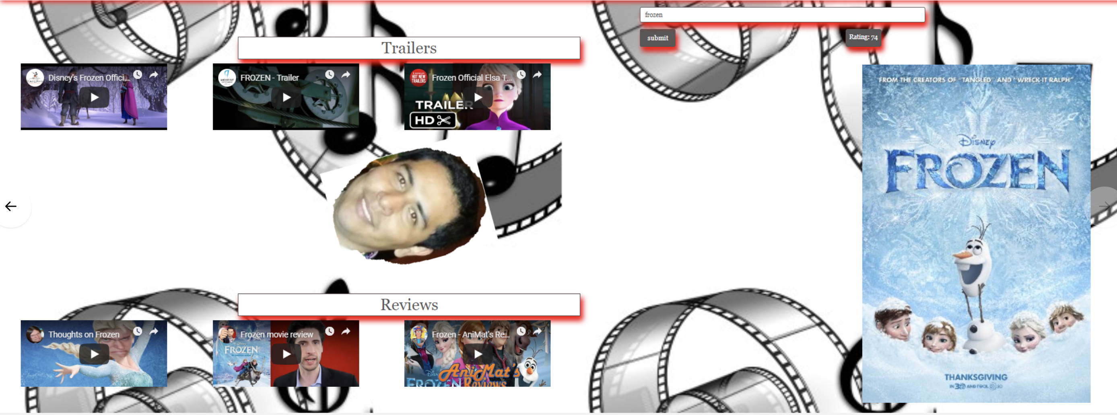

Slide 10
App Updates
Places I can watch
Recommendation section based on favorites list
Social Media – share favorites list with friends

